Slide 1
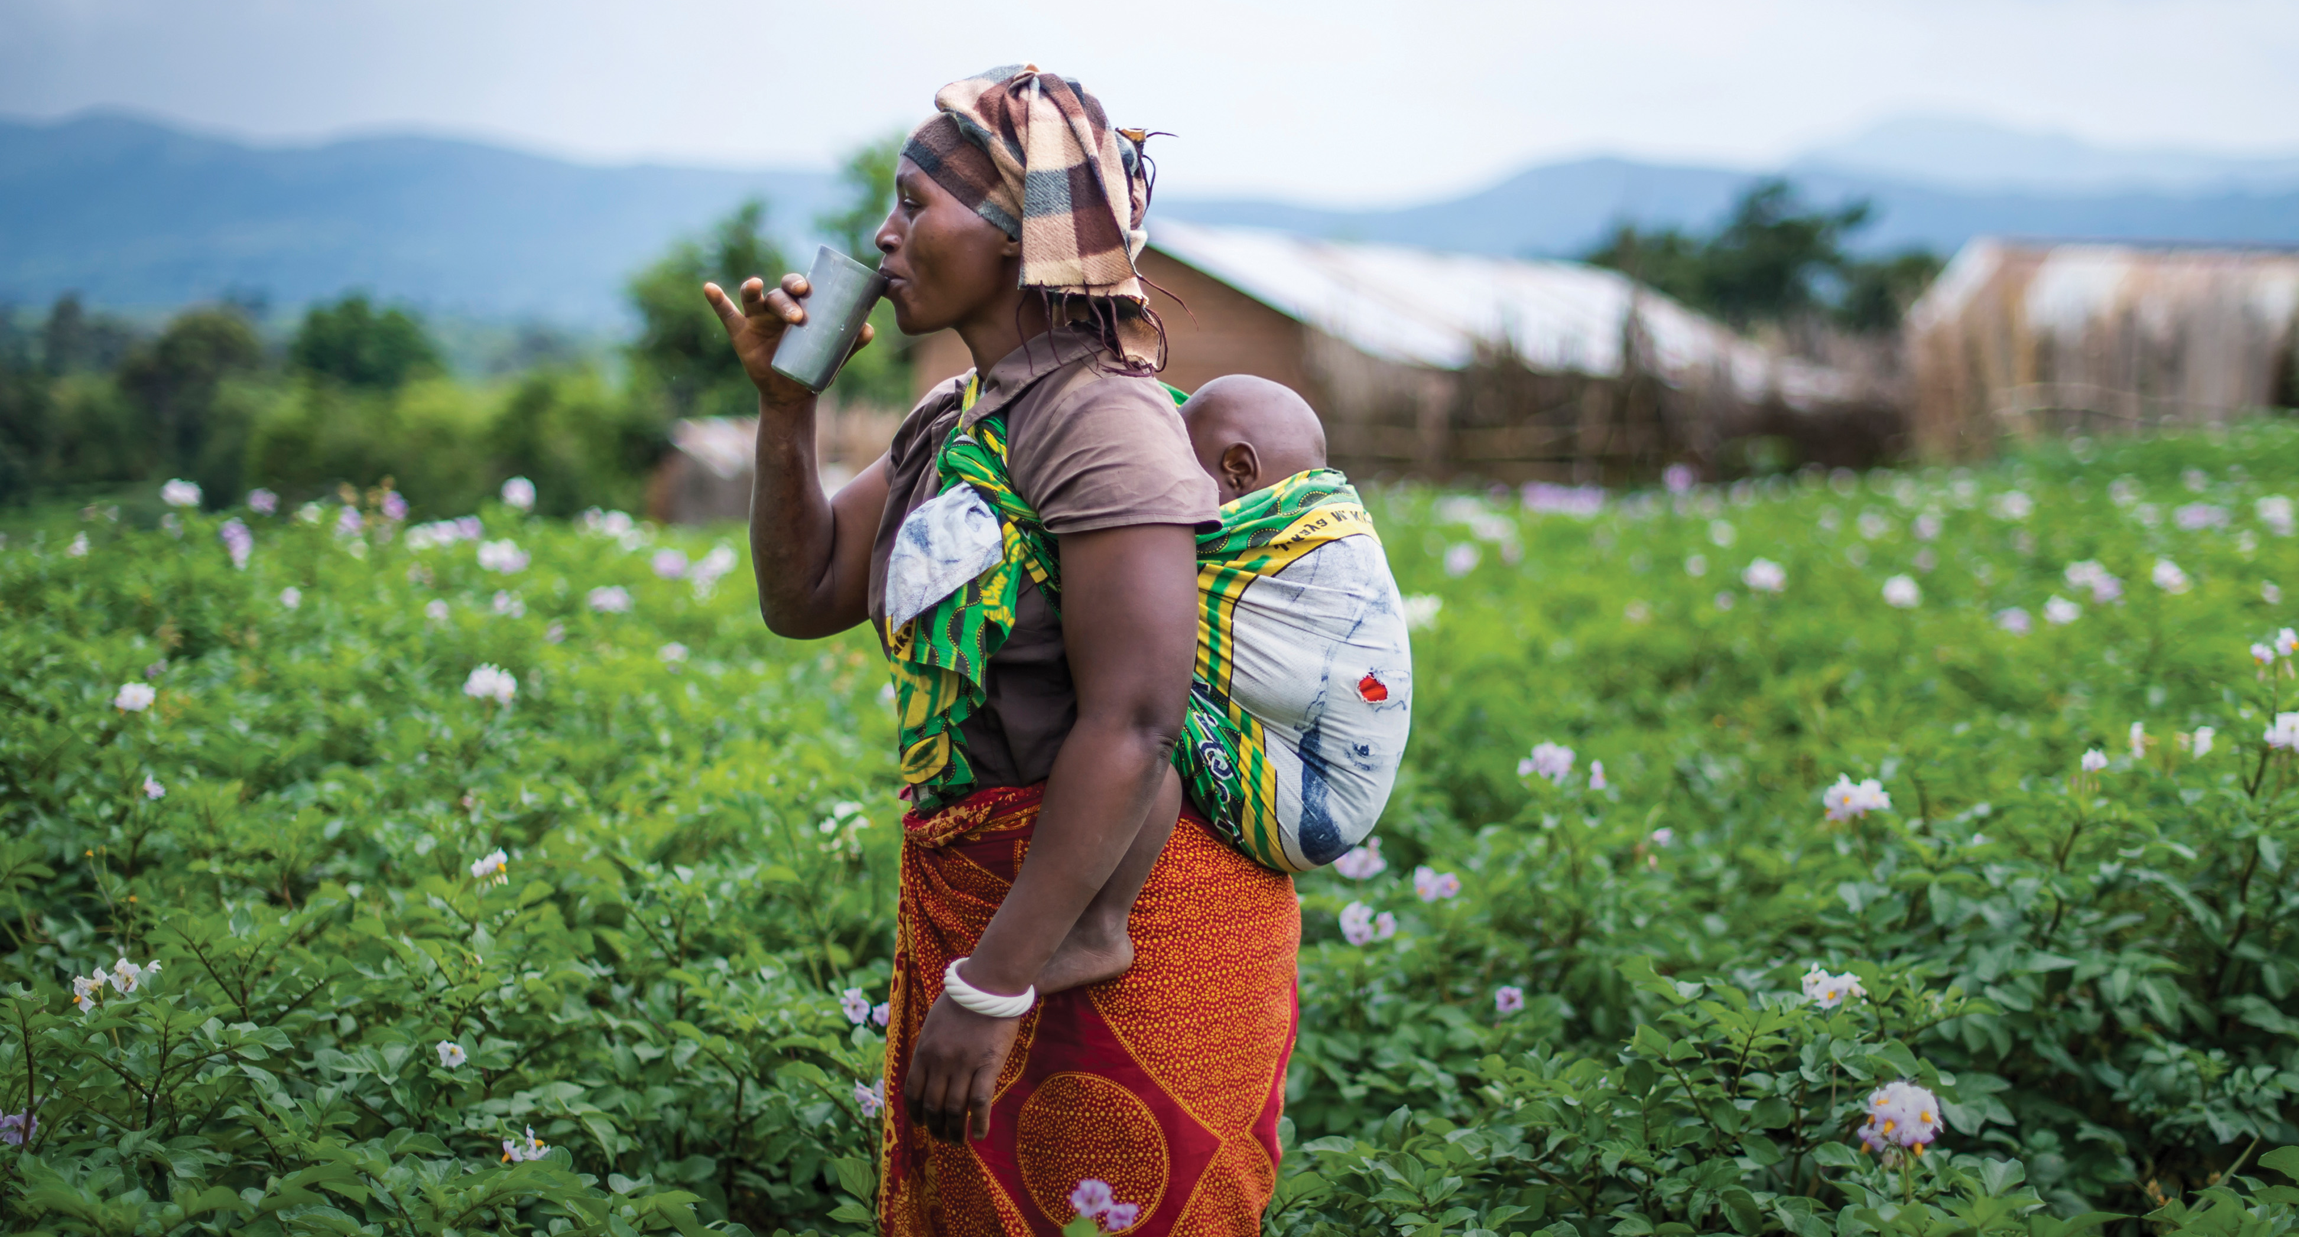
water builds
Notes:
Slide to feature photo with white transparent logo

Slide 2
Advintage Impact Report

Slide 3
IMPACT
Funds provided by Advintage in 2015 enabled Water Mission to provide safe and Living Water:
In 8 countries – Haiti, Honduras, Indonesia, Kenya, Malawi, Mexico, Philippines, and Uganda
Through 27 projects – all of which are near completion, either in the Implementation or Follow-up stages

Slide 4
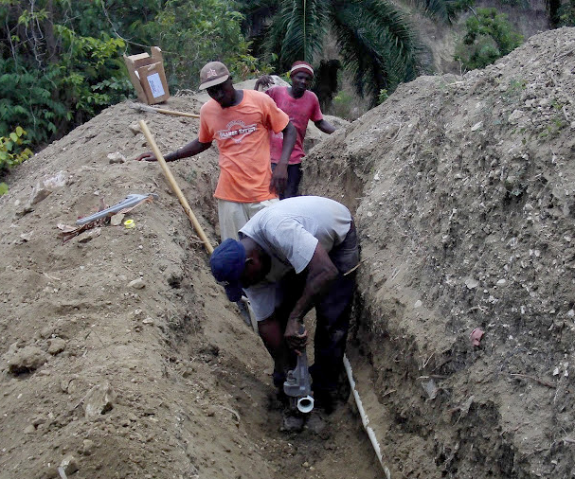
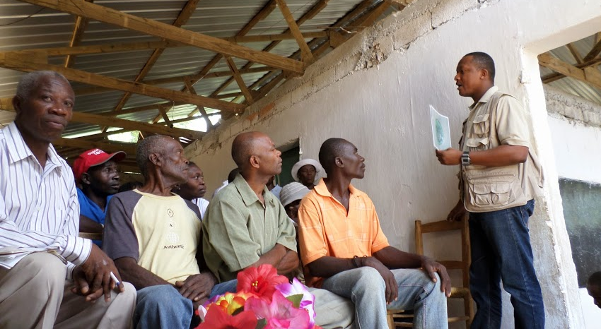
HAITI
COMMUNITY | POPULATION SERVED
Desriveaux, Pestel | 5,800
Camp Marie | 4,000

Slide 5
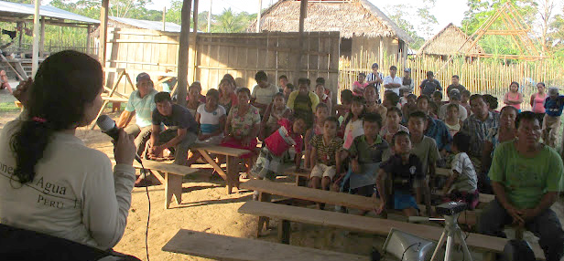
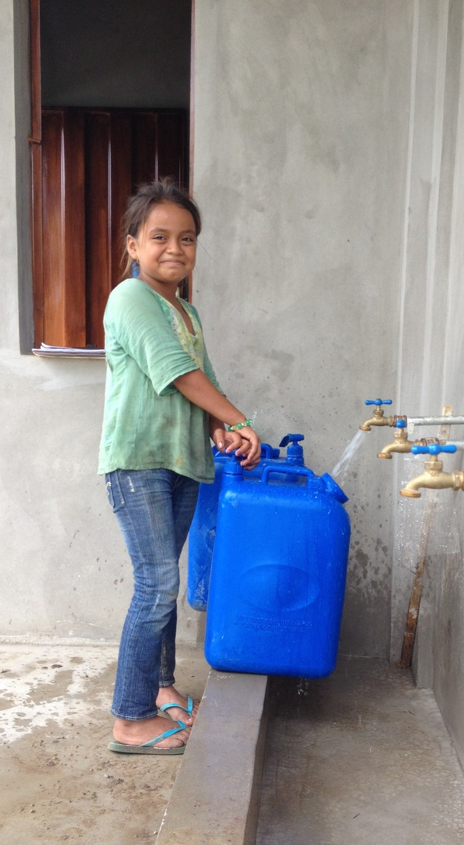
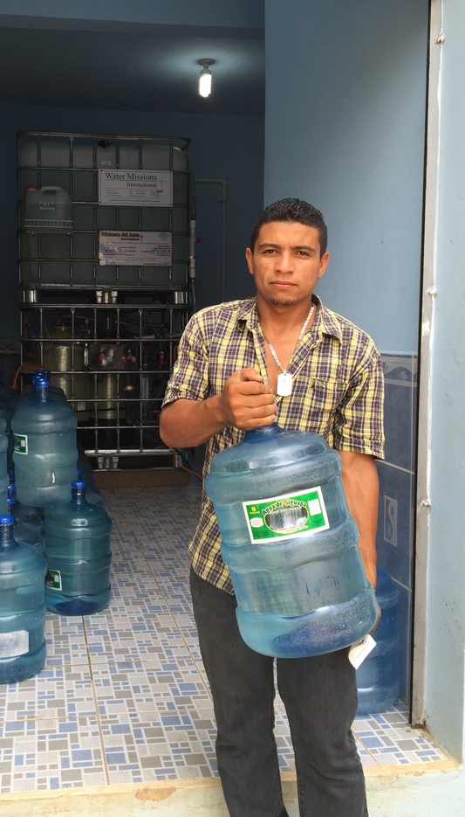
HONDURAS
COMMUNITY | POPULATION SERVED
Bo Bella Vista | 1,250
Pisijire | 1,750
Sinar | 325

Slide 6
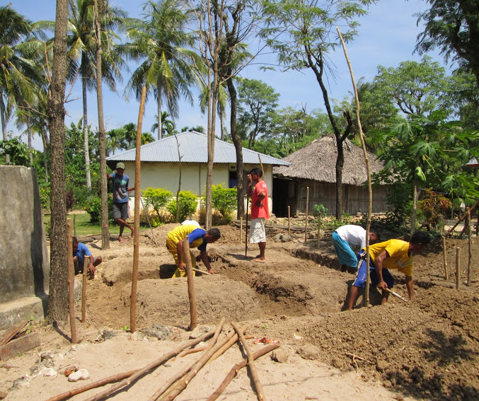
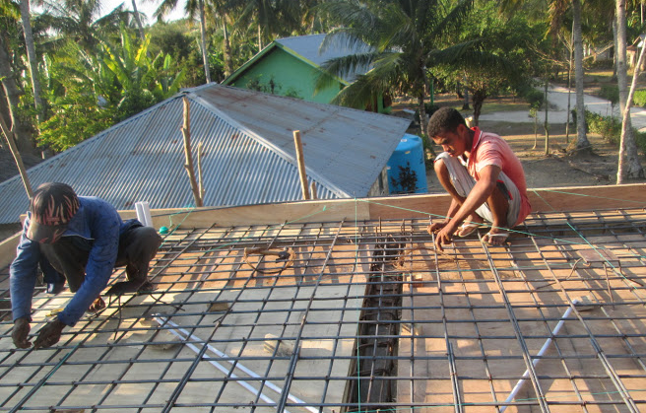
INDONESIA
COMMUNITY | POPULATION SERVED
Bone | 1,400

Slide 7
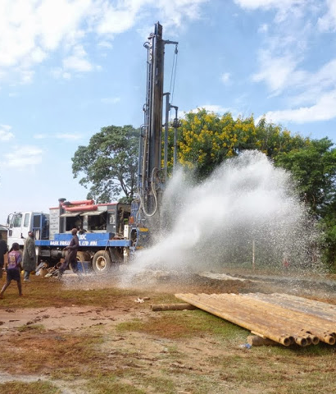
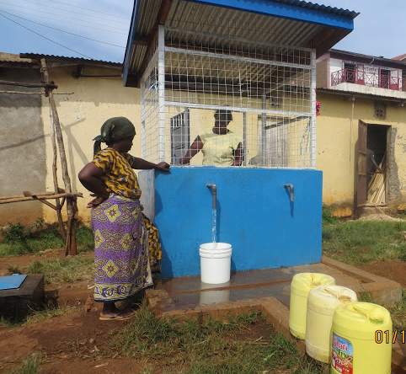
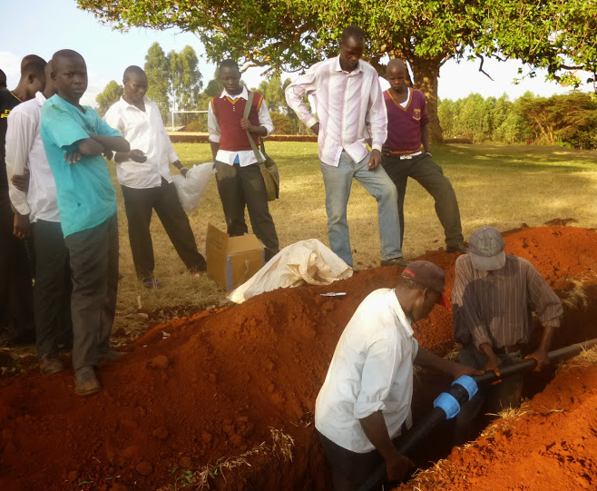
KENYA
COMMUNITY | POPULATION SERVED
Kapsokwony Secondary School | 4,425
Bumala | 4,000

Slide 8
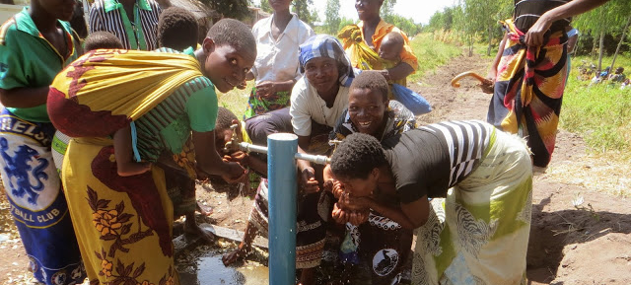
MALAWI
COMMUNITY | POPULATION SERVED
Tizola | 10,132
Mchenga | 5,239
Livunzu School | 2,814
Bodza School | 3,125
Savala | 5,090
Mlonda School | 4,182
Magoti | 4,912
Chigwamafuma | 5,700

Slide 9
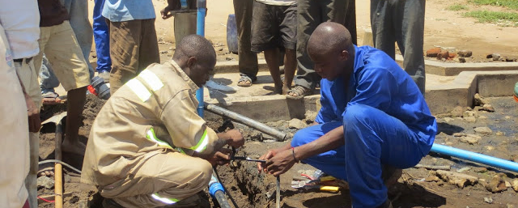
MALAWI continued
COMMUNITY | POPULATION SERVED
Dindi School | 7,554
Khungubwe Hall | 2,562
Makhanga School | 2,809
Mlambala RC | 3,136
Nambazo School | 3,761
Osiyana | 3,750
Tchereni School | 7,487
Tizola 2 | 5,050

Slide 10
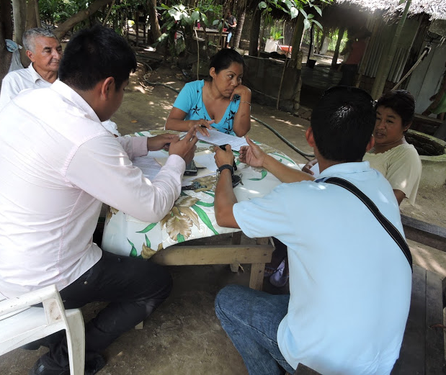
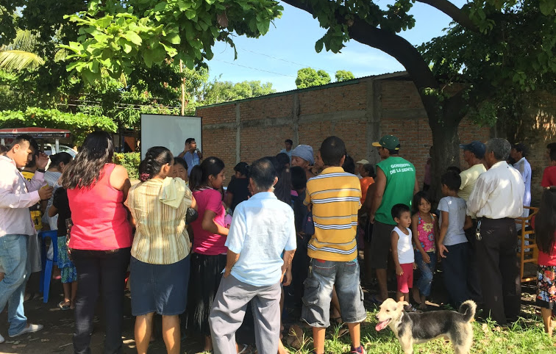
MEXICO
COMMUNITY | POPULATION SERVED
El Encanto | 2,020

Slide 11
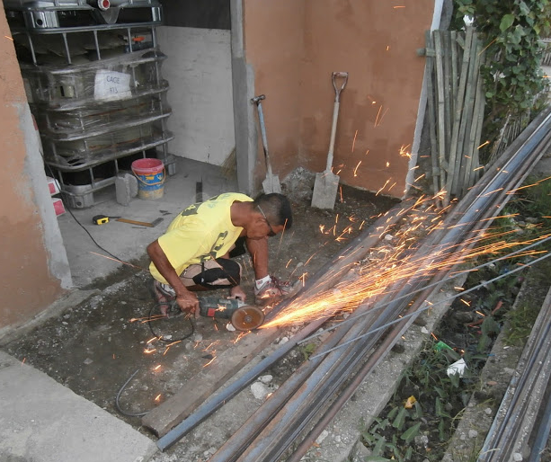
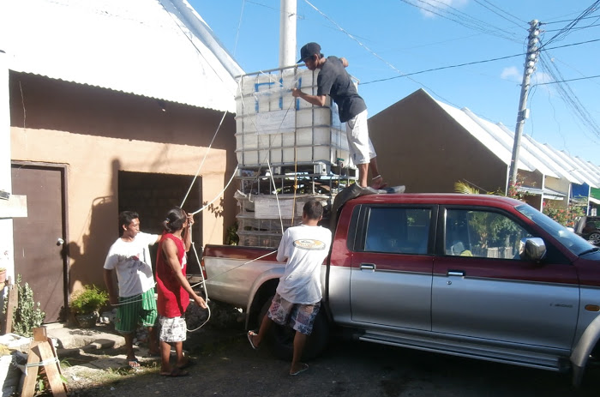
PHILIPPINES
COMMUNITY | POPULATION SERVED
Haiyan | 85,543

Slide 12
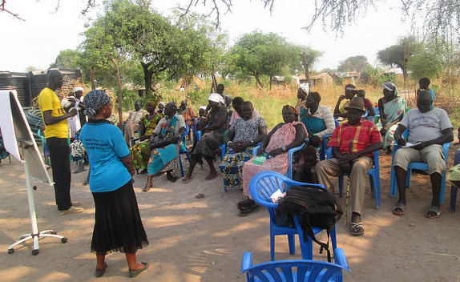
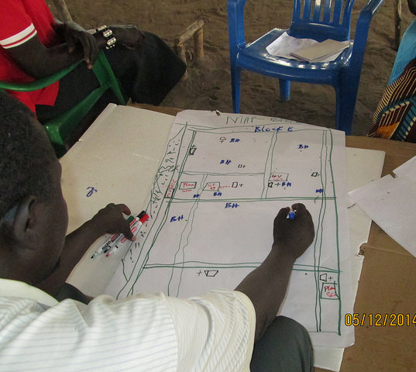
UGANDA
COMMUNITY | POPULATION SERVED
Nyumanzi Health Ctr | 7,000

Slide 13
194,816
PEOPLE REACHED

Slide 14
Thank You

